Slide 1
ניתוח אסטרטגיות אופטימליות במשחקים מרקובים
אופק הררי
אלדד וינר
מנחה: איתי צברי
NSSL
סמסטר אביב
2020

Slide 2
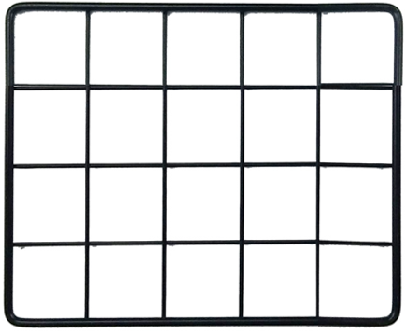





Game Strategy
Actions:

Slide 3

Stochastic Game Strategy
Actions:
Actions probabilities table :
0.1 | 0.1 | 0.1 | 0.7
0.1 | 0.1 | 0.7 | 0.1
0.1 | 0.7 | 0.1 | 0.1
0.7 | 0.1 | 0.1 | 0.1

Slide 4
MDP – Markov Decision Process
Discrete-time stochastic control process
Extension of Markov chains
Addition of actions (choice)
Addition of rewards (goal)

Slide 5
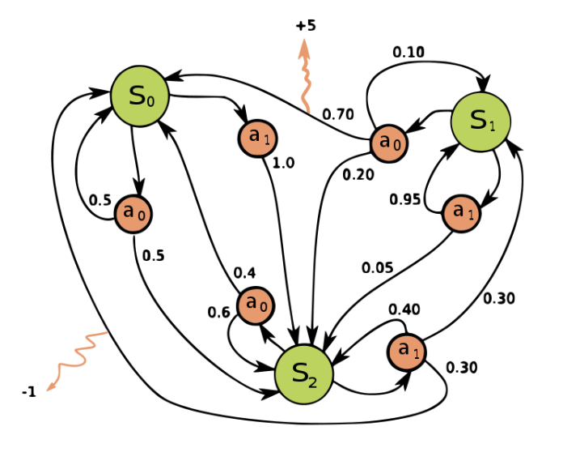

MDP – Definitions
MDP is a 4-tuple $\left( S , A , P_{a} , R_{a}\right)$ when:
S - finite state space
A - finite set of actions
$P_{a}$ - transition function ($\operatorname{Pr}\left(s_{t+1}=s^{′} \right|s_{t}=s, a_{t}=a)$)
$R_{a}$- reward function ($R(s,s^{′},a)$)

Slide 6

MDP - Goal
Strategy:
$Π$: mapping from state to action
$Π^{∗}$: maximize the expectancy reward
The goal : find $Π^{∗}$
There is a closed solution to the problem using dynamic programming

Slide 7


Our Goals
Main goal :
Building a system that provides an optimal solution for MDP problem
Secondary goal :
Finding optimal Bitcoin selfish mining strategy using MDP solver
Optimal SM
problem
MDP
solver
MDP
problem
$$Π^{∗}$$

Slide 8
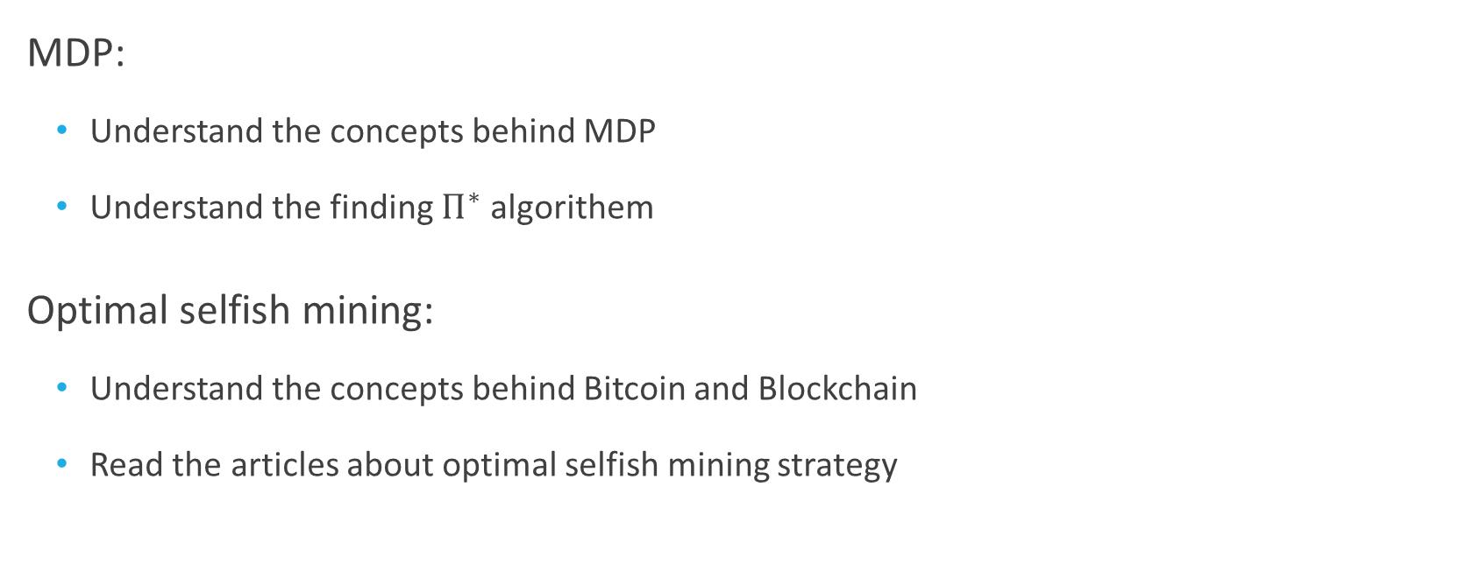
Learning phase
MDP:
Understand the concepts behind MDP
Understand the finding $Π^{∗}$ algorithem
Optimal selfish mining:
Understand the concepts behind Bitcoin and Blockchain
Read the articles about optimal selfish mining strategy

Slide 9
Project Methods
Programing language: Java
Version-control system: Git
Creating generic system using OOP design

Slide 10
What’s Next?
Modeling optimal selfish mining problem as MDP
Finding optimal strategy using MDP solver
Compare the strategy for different configurations of the problem

